Slide 1
Texas State University
College Prep
Mr. Gordon
jgordon@bisdtx.org

Slide 2
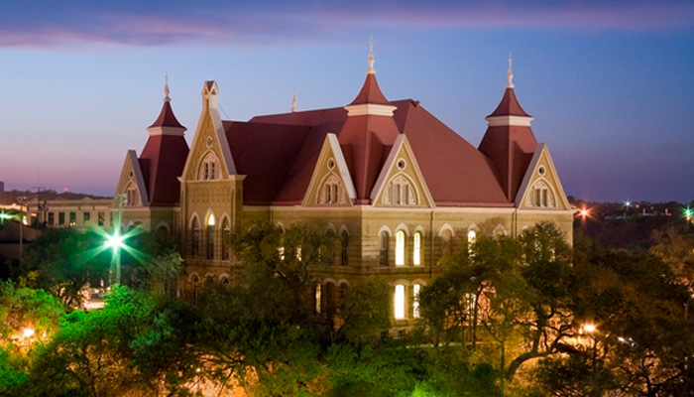
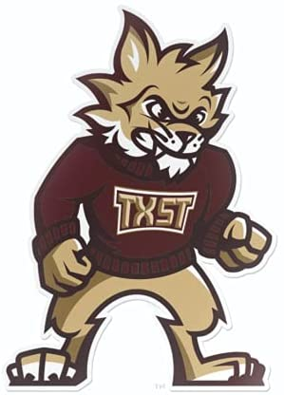
Texas State University Facts
Texas State is located in San Marcos, TX
45 mins from CRCA
Texas State is a public university.
Texas State’s mascot is Boko the Bobcat.
By far, more CRCA students attend Texas State than any other college.
hi

Slide 3
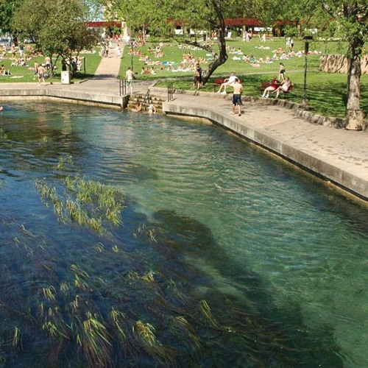
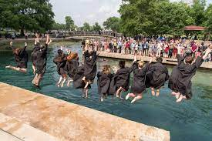
Texas State University Facts
Sewell Park is located right beside campus. Many students go here to swim, kayak, and sunbathe. We will see it when we visit.
Students jump into the river in their cap and gown after graduation.
Texas State is the 7th largest college in Texas.
hi

Slide 4
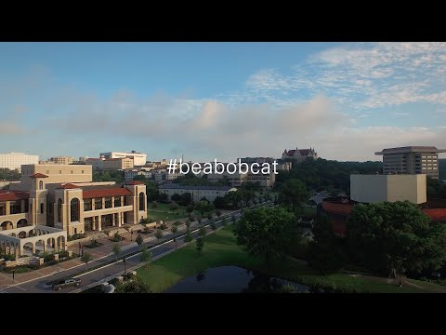
Texas State University Video
Watch this video
hi

Slide 5
About Texas Tech University
Go here and here to answer the following questions.
1.How many students attend Texas State University?
2. Which U.S. President graduated from Texas State?
3. What is one tradition that you found interesting?
5. How many degrees does Texas State offer?
Now that you are familiar with college websites,
do some of your own research.
hi

Slide 6
College Prep Assignment
In the comments section of today’s College Prep,
answer the following question:
What is one thing you liked or disliked about
Texas State University?
hi

